Slide 1
Fluent Design System
Learn how to design and develop apps using the Fluent Design System.
Get started

Slide 2
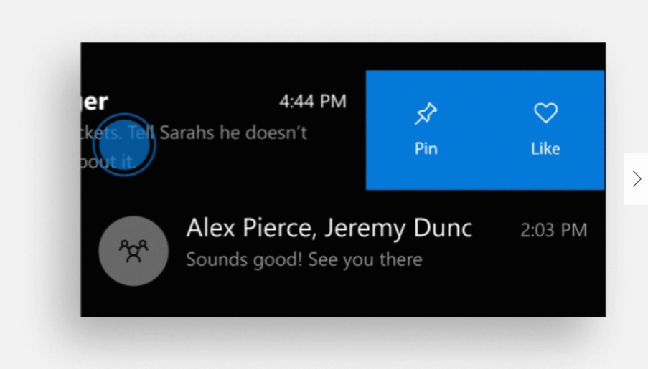
What’s new in Fluent Design
Swipe it
Enhance your lists with swipe-to-delete and pull-to-refresh.
ENABLE SWIPE >

Slide 3
What’s new in Fluent Design
Swipe it
Enhance your lists with swipe-to-delete and pull-to-refresh.
ENABLE SWIPE>

Slide 4
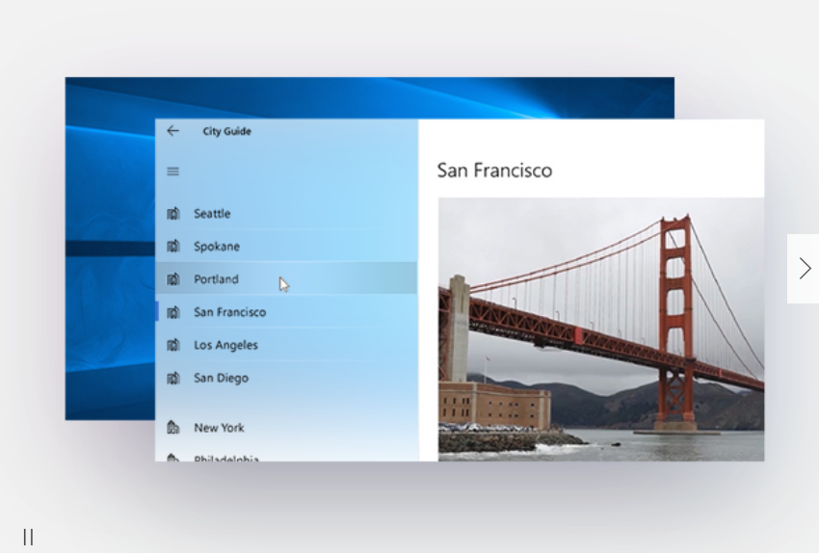
What’s new in Fluent Design
Navigation view
This control makes it easy to add multi-page navigation to your app. And it's responsive, too.
TRY THE NAV VIEW

Slide 5
What’s new in Fluent Design
Navigation view
This control makes it easy to add multi-page navigation to your app. And it's responsive, too.
TRY THE NAV VIEW

Slide 6
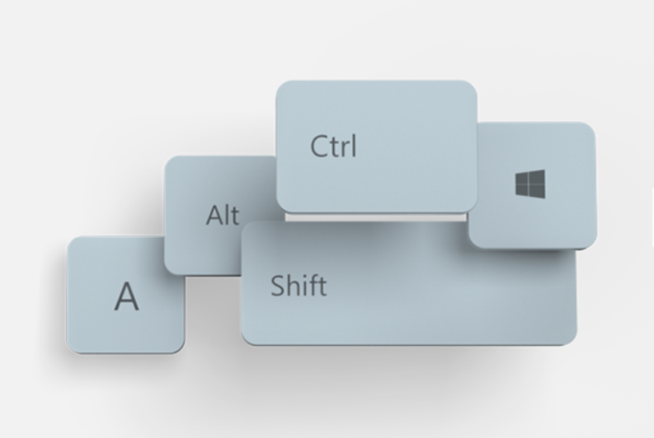
What’s new in Fluent Design
Keyboard shortcuts
Improve the usability of your app with these keyboard shortcuts.
ADD SHORTCUTS

Slide 7
What’s new in Fluent Design
Keyboard shortcuts
Improve the usability of your app with these keyboard shortcuts.
ADD SHORTCUTS

Slide 8


1
2
Design basics
Layout
An introduction to app design and the Fluent Design System.
Responsive tips and APIs for a UI that looks great on every screen size.
READ MORE >
READ MORE >
3
4

Slide 9


1
2
3
4
Controls and Patterns
Style
All the UI building blocks you need, from radio buttons to navigation controls.
Make your app stand out with color, typography, acrylic, and reveal.
READ MORE >
READ MORE >
5
6

Slide 10


1
2
3
4
5
6
Motion
Shell
Bring your app to life with animations and transitions.
Create tiles for launching your app and display notifications.
READ MORE >
READ MORE >
7
8

Slide 11



1
2
3
4
5
6
7
8
Input and interactions
Devices
Optimize your app for pen, Surface dial, and other input types.
Learn about the spectrum of Windows 10 devices and how to optimize for them.
READ MORE >
READ MORE >
13
Usability
Make your app inclusive and accessible to people around the world.
READ MORE >

Slide 12
1
2
3
4
5
6
7
13
8
Input and interactions
Usability
Devices
Optimize your app for pen, Surface dial, and other input types.
Make your app inclusive and accessible to people around the world.
Learn about the spectrum of Windows 10 devices and how to optimize for them.
READ MORE >
READ MORE >
READ MORE >

Slide 13
Latest news
1
1
1
1
Science in the System: Fluent Design and Material
Science in the System: Fluent Design and Light
12 Fluent Design elements to add to your app
Design System Fundamentals
Microsoft Design
Microsoft Design
Microsoft Design
Microsoft Design

Slide 14
Latest news
1
1
1
1
Science in the System: Fluent Design and Material
Science in the System: Fluent Design and Light
12 Fluent Design elements to add to your app
Design System Fundamentals
Microsoft Design
Microsoft Design
Microsoft Design
Microsoft Design

